Slide 1



MUSIC RECOMMENDER SYSTEM

Slide 2
Our Team Members
Jairaj Kumar
Pulkit Agarwal
Manjeet Yadav
Rudrani Mondal
Aditi

Slide 3
What are Recommendations?
How does youtube know what video you might want to watch next? How does the google play store pick an app just for you? magic? No, in both cases, an ml-based recommendation model determines how similar videos and apps are to other things you like and then serves up a recommendation. Two kinds of recommendations are commonly used:
Home page recommendations
Related item recommendations

Slide 4
Why Recommendations?
A recommendation system helps users find compelling content in a large corpora. For example, the Google Play Store provides millions of apps, while YouTube provides billions of videos. More apps and videos are added every day. How can users find new compelling new content? Yes, one can use search to access content. However, a recommendation engine can display items that users might not have thought to search for on their own.

Slide 5
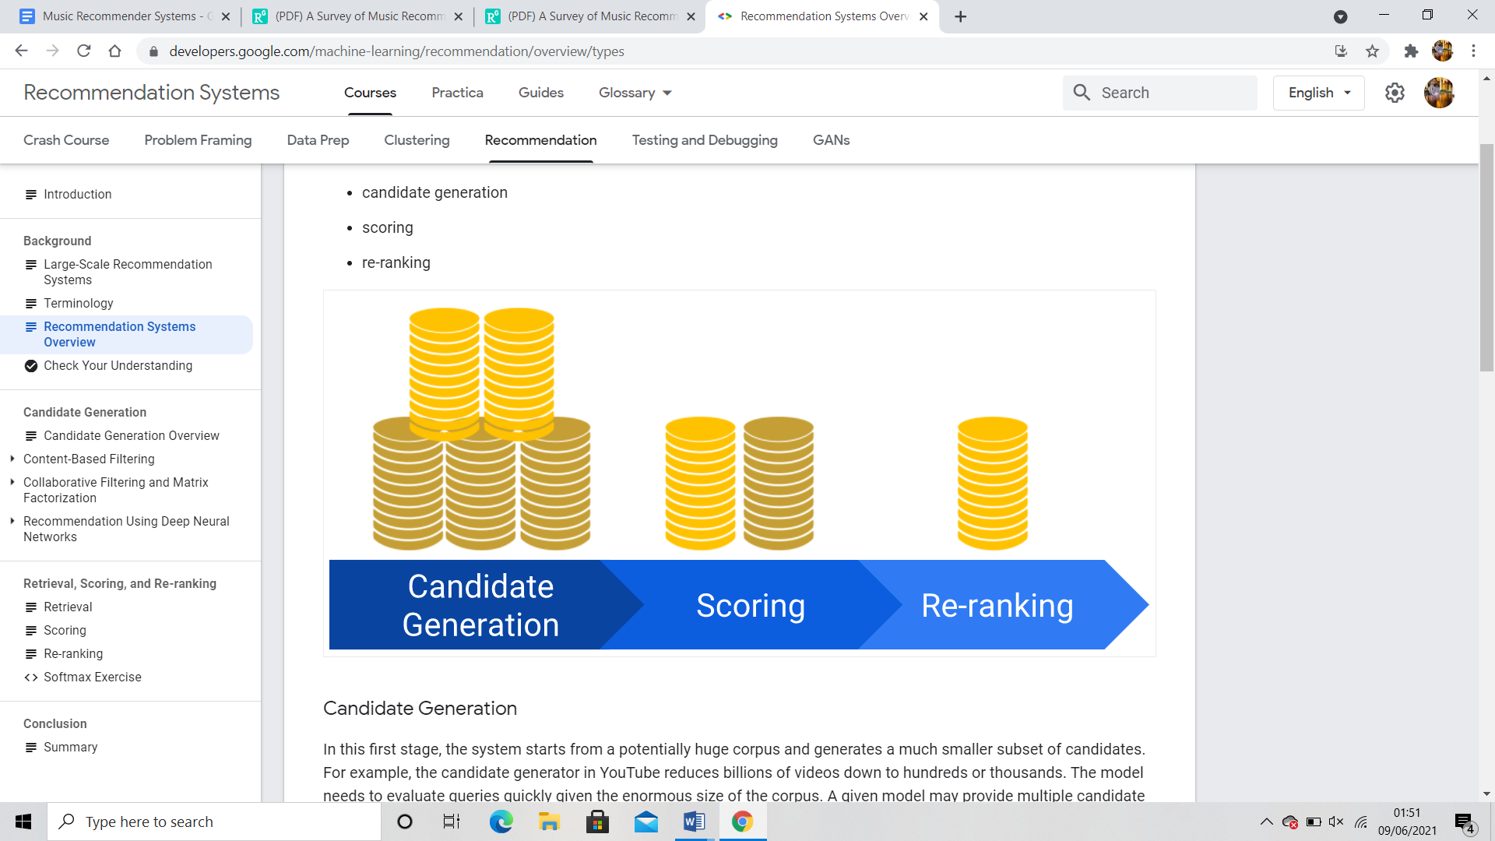
Recommendation Systems Overview
One common architecture for recommendation systems consists of the following components:
candidate generation
scoring
re-ranking

Slide 6
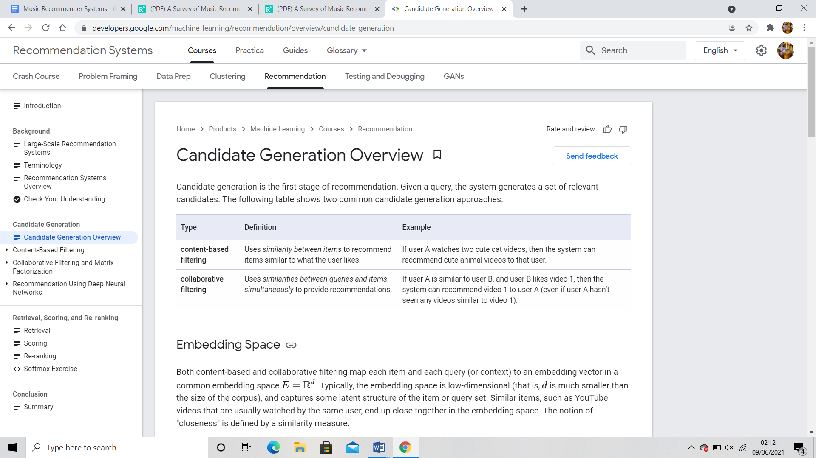
Candidate Generation Overview
Candidate generation is the first stage of recommendation. Given a query, the system generates a set of relevant candidates. The following table shows two common candidate generation approaches:

Slide 7
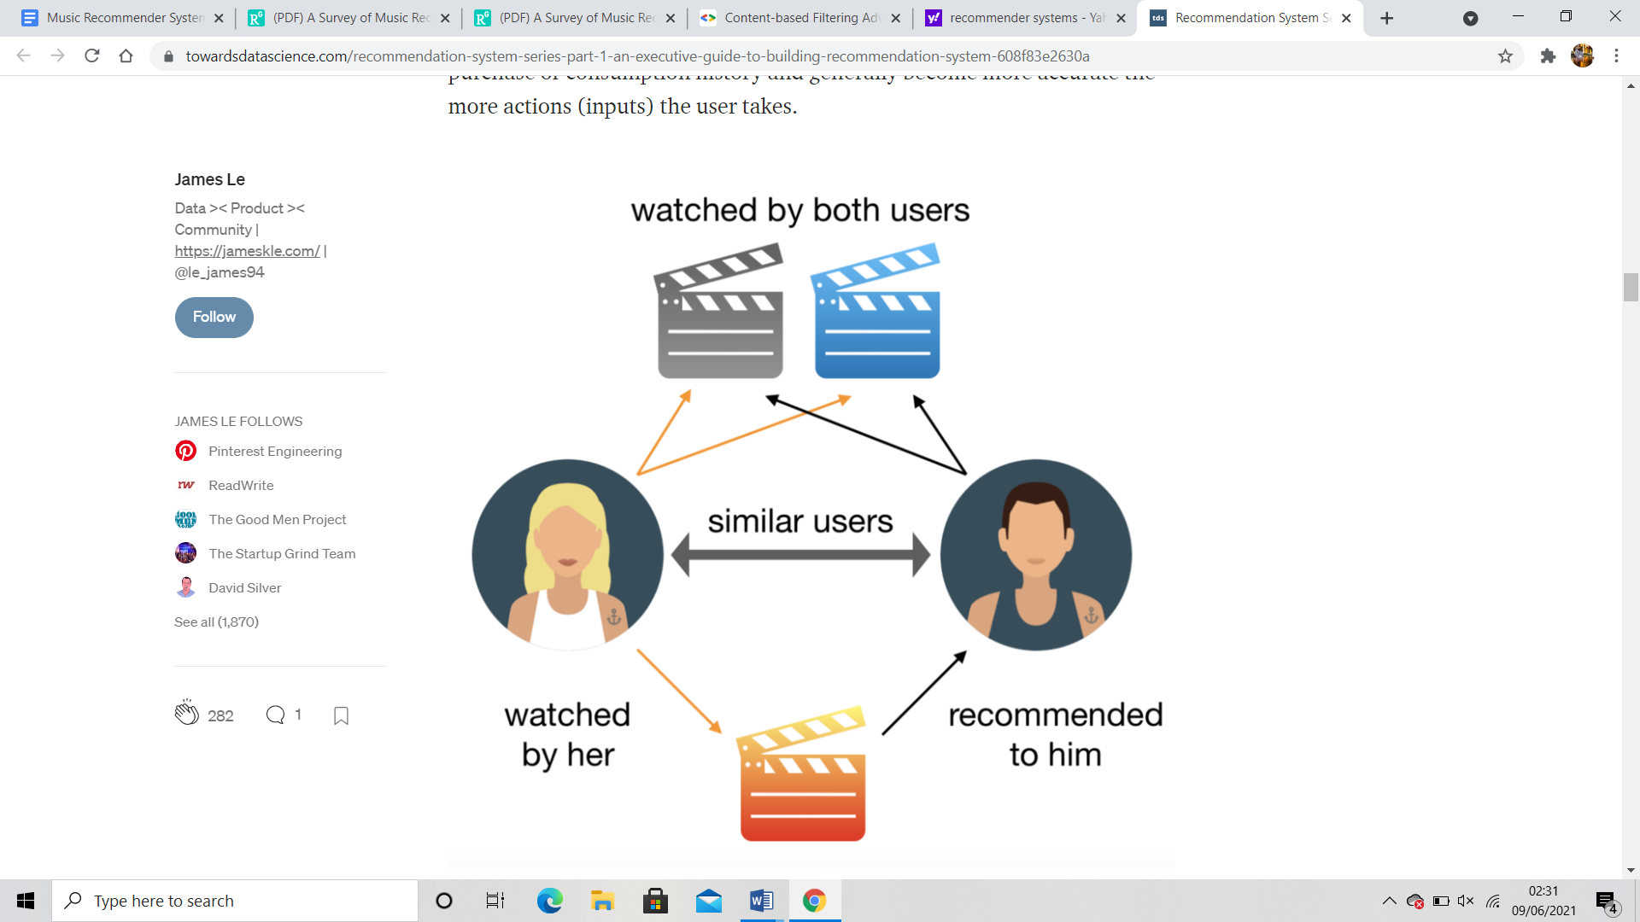
Content-based Filtering
Content-based systems make recommendations based on the user’s purchase or consumption history and generally become more accurate the more actions (inputs) the user takes.

Slide 8
More specific types of content-based recommendation systems include:
By Content Similarity: As the most basic type of content-based recommendation system, this strategy involves recommending content that is close based on its metadata. This approach makes sense for catalogs with a lot of rich metadata and where traffic is low compared to the number of products in the catalog.
By Latent Factor Modeling: Going one step further than the content similarity approach, the crux of this strategy is inferring individuals’ inherent interests by assuming that previous choices are indicative of certain tastes or hobbies. Where the previous strategy is based on explicit, manually filled catalog metadata, this strategy hinges on discovering implicit relationships. This is done by using the history of users’ larger interactions (e.g., movie watched, item purchased, etc.) to learn these tastes.

Slide 9
By Topic Modeling: This is a variant of the Latent Factor Modeling strategy, whereby instead of considering users’ larger actions, one would infer interests by analyzing unstructured text to detect particular topics of interest. It is particularly interesting for use cases with rich but unstructured textual information (such as news articles).
By Popular Content Promotion: This involves highlighting product recommendations based on the product’s intrinsic features that may make it interesting to a wide audience: price, feature, popularity, etc. This strategy can also take into account the freshness or age of the content and thus enable using the most trendy content for recommendations. This is often used in cases where new content is the majority.

Slide 10
Advantages and Disadvantages OF Content-based Filtering
Advantages
The model doesn't need any data about other users, since the recommendations are specific to this user. This makes it easier to scale to a large number of users.
The model can capture the specific interests of a user, and can recommend niche items that very few other users are interested in.
Disadvantages
Since the feature representation of the items are hand-engineered to some extent, this technique requires a lot of domain knowledge. Therefore, the model can only be as good as the hand-engineered features.
The model can only make recommendations based on existing interests of the user. In other words, the model has limited ability to expand on the users' existing interests.

Slide 11
Collaborative Filtering

Slide 12
WHAT IS COLLABORATIVE FILTERING?
To recommend items via the choice of other similar users
it assumes that if user X and Y rate n items similarly or have similar behaviour, they will rate or act on other items similarly
The standard method of Collaborative Filtering is known as Nearest Neighbourhood algorithm
Instead of calculating the similarity between items, a set of ‘nearest neighbour’ users for each user whose past ratings have the strongest correlation are found. Therefore, scores for the unseen items are predicted based on a combination of the scores known from the nearest neighbours
divided into three subcategories: memory-based, model-based, and hybrid collaborative filtering

Slide 13
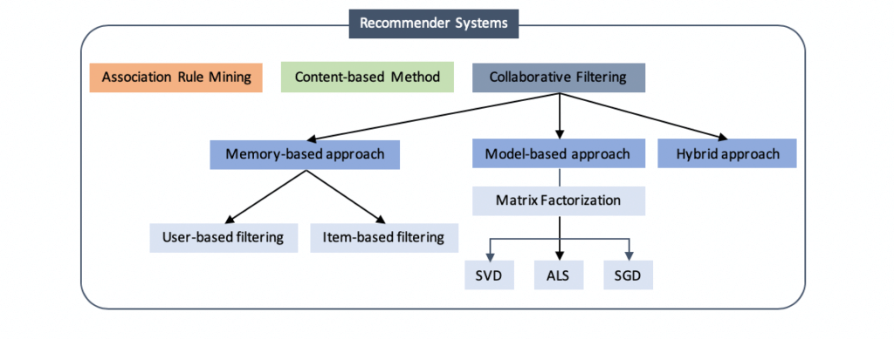
TYPES OF CF
1. MEMORY BASED APPROACH
A) for User-based CF We have an n × m matrix of ratings, with user uᵢ, i = 1, ...n and item pⱼ, j=1, …m. Now we want to predict the rating rᵢⱼ if target user i did not watch/rate an item j. The process is to calculate the similarities between target user i and all other users, select the top X similar users, and take the weighted average of ratings from these X users with similarities as weights.
some people tend to give high scores generally some are pretty strict even though they are satisfied with items. To avoid this bias, we can subtract each user’s average rating of all items when computing weighted average, and add it back for target user

Slide 14

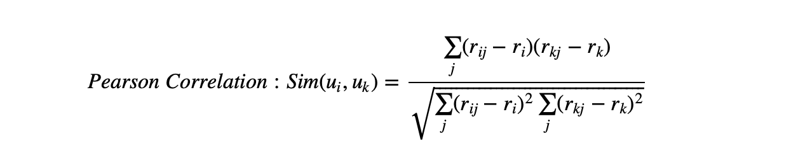
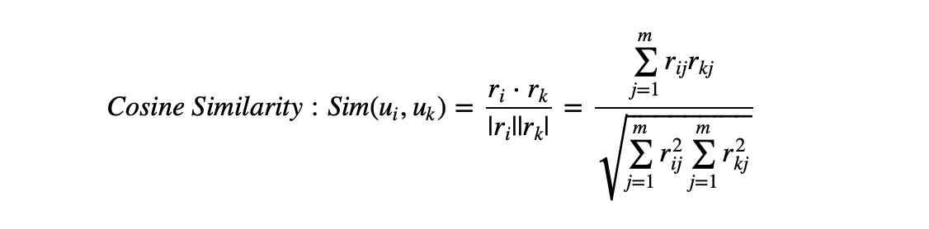
Two ways to calculate similarity are Pearson Correlation and Cosine Similarity.
Basically, the idea is to find the most similar users to your target user (nearest neighbours) and weight their ratings of an item as the prediction of the rating of this item for target user.
Without knowing anything about items and users themselves, we think two users are similar when they give the same item similar ratings .

Slide 15
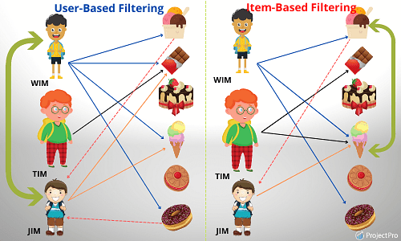
B)for Item-based CF, we say two items are similar when they received similar ratings from a same user. Then, we will make prediction for a target user on an item by calculating weighted average of ratings on most X similar items from this user.
advantage of Item-based CF is the stability which is that the ratings on a given item will not change significantly overtime, unlike the tastes of human beings

Slide 16
LIMITATIONS OF MEMORY BASED APPROACH
Popularity bias Generally, popular music can get more ratings. The music in long tail, however, can rarely get any. As a result, collaborative filtering mainly recommend the popular music to the listeners. Though giving popular items are reliable, it is still risky, since the user rarely get pleasantly surprised.
Cold start It is also known as data sparsity problems. At an early stage, few ratings is provided. Due to the lack of these ratings, prediction results are poor.
Human effort A perfect recommender system should not involve too much human efforts, since the users are not always willing to rate. The ratings may also grow towards those who do rate, but it may not be representative. Because of this absence of even distributed ratings, it can either give us false negative or false positive results.

Slide 17

2.MODEL BASED APPROACH
MATRIX FACTORISATION
Beside solving the issues of sparsity and scalability, it provides low-dimensional matrices to represent users’ preference
matrix factorization eventually gives us is how much a user is aligned with a set of latent features, and how much a movie fits into this set of latent features. The advantage of it over standard nearest neighbourhood is that even though two users haven’t rated any same movies, it’s still possible to find the similarity between them if they share the similar underlying tastes, again latent features.
Singular Value Decomposition(SVD). Based on Linear Algebra, any real matrix R can be decomposed into 3 matrices U, Σ, and V.

Slide 18
To sort the values of Σ by decreasing absolute value and truncate matrix Σ to first k dimensions( k singular values), we can reconstruct the matrix as matrix A. The selection of k should make sure that A is able to capture the most of variance within the original matrix R, so that A is the approximation of R, A ≈ R
When matrix R is dense, U and V could be easily factorized analytically. However, a matrix of movie ratings is super sparse. Although there are some imputation methods to fill in missing values , we will turn to a programming approach to just live with those missing values and find factor matrices U and V. Instead of factorizing R via SVD, we are trying find U and V directly with the goal that when U and V multiplied back together the output matrix R’ is the closest approximation of R and no more a sparse matrix. This numerical approximation is usually achieved with Non-Negative Matrix Factorization for recommender systems since there is no negative values in ratings.

Slide 19
Cold Start Problem
Recommendation systems have a prevalent cold start problem. This problem is occurred might due to new users or new items are added into the system. The systems do not understand the new user’s preferences, therefore systems can not recommend the item to users.
In eCommerce there are two distinct categories of cold start:
New-User cold start
New-Item cold start

Slide 20
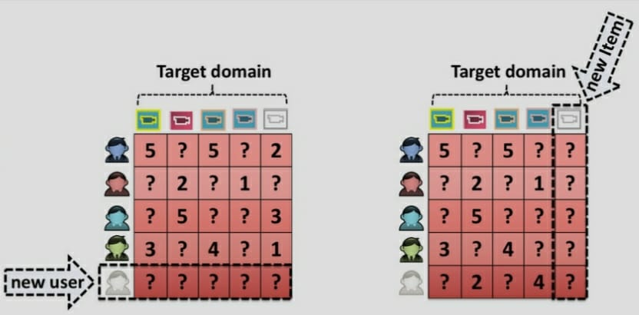

Slide 21
1.New user cold start
When system is not able to produce preferences for the new user due to lack of search history and rating information is called new-user cold start problem.
2. New item cold start
When it is not possible to place new items at the top of the preference list, is known as new item cold start problem.
Collaborative filtering is affected by the new user and new item cold-start problems, however the content-based recommendation suffers only from a new user cold start problem.

Slide 22
The solution (Approaches)
Researchers have purposed various ways to tackle the cold start problem:
1.Representative based: use subset of items and users that represent the population
2.Content based: use of side information such as text, social network, etc.
3. Bandit: consider the exploration vs exploitation tradeoff in new item.
4. Deep Learning: recent methods that tries to solve some issues tackled above but using a black box.

Slide 23
DATA DESCRIPTION
(The Million Song Dataset Challenge)
DATA FIELDS
USER ID →It specifies the unique user.
SONG ID → It specify unique song. every song is represented by different id
TASTE ID → It shows the similarities of the songs (like rap,sad,romantic)
ARTISTS → It contains the name of song artists
SONG NAME → Name of the song
VALUE COUNT → No. of times a song played by each user.

Slide 24
PROBLEM SOLVING
First we will convert text data into csv
Then we will do data processing (like merging and removing data)
After completing data preprocessing we will move towards EDA
After Eda we will get proper idea of data
Then we will try to implement Collaborative filtering, Popularity Based Recommendation System and Content based filtering and will keep eye on cold start problem while implementing.
Then we will do model analysis.

Slide 25



